Slide 1
Predicting Winners of Basketball Games
Tuyen Duong, Dara Hashemi, Ki Hyun Park
101CMonsters
Stats 101C

Slide 2
Organizing Data
Removed variables which did not play a big role in our data (id, gameID, HT, VT, HT league, VT league)
Created a binary response variable
Removed perfectly collinear (redundant) variables
Tested methods: Ridge Regression, Lasso, PCR, LDA, Logistic Regression, KNN-cv, Boosting

Slide 3
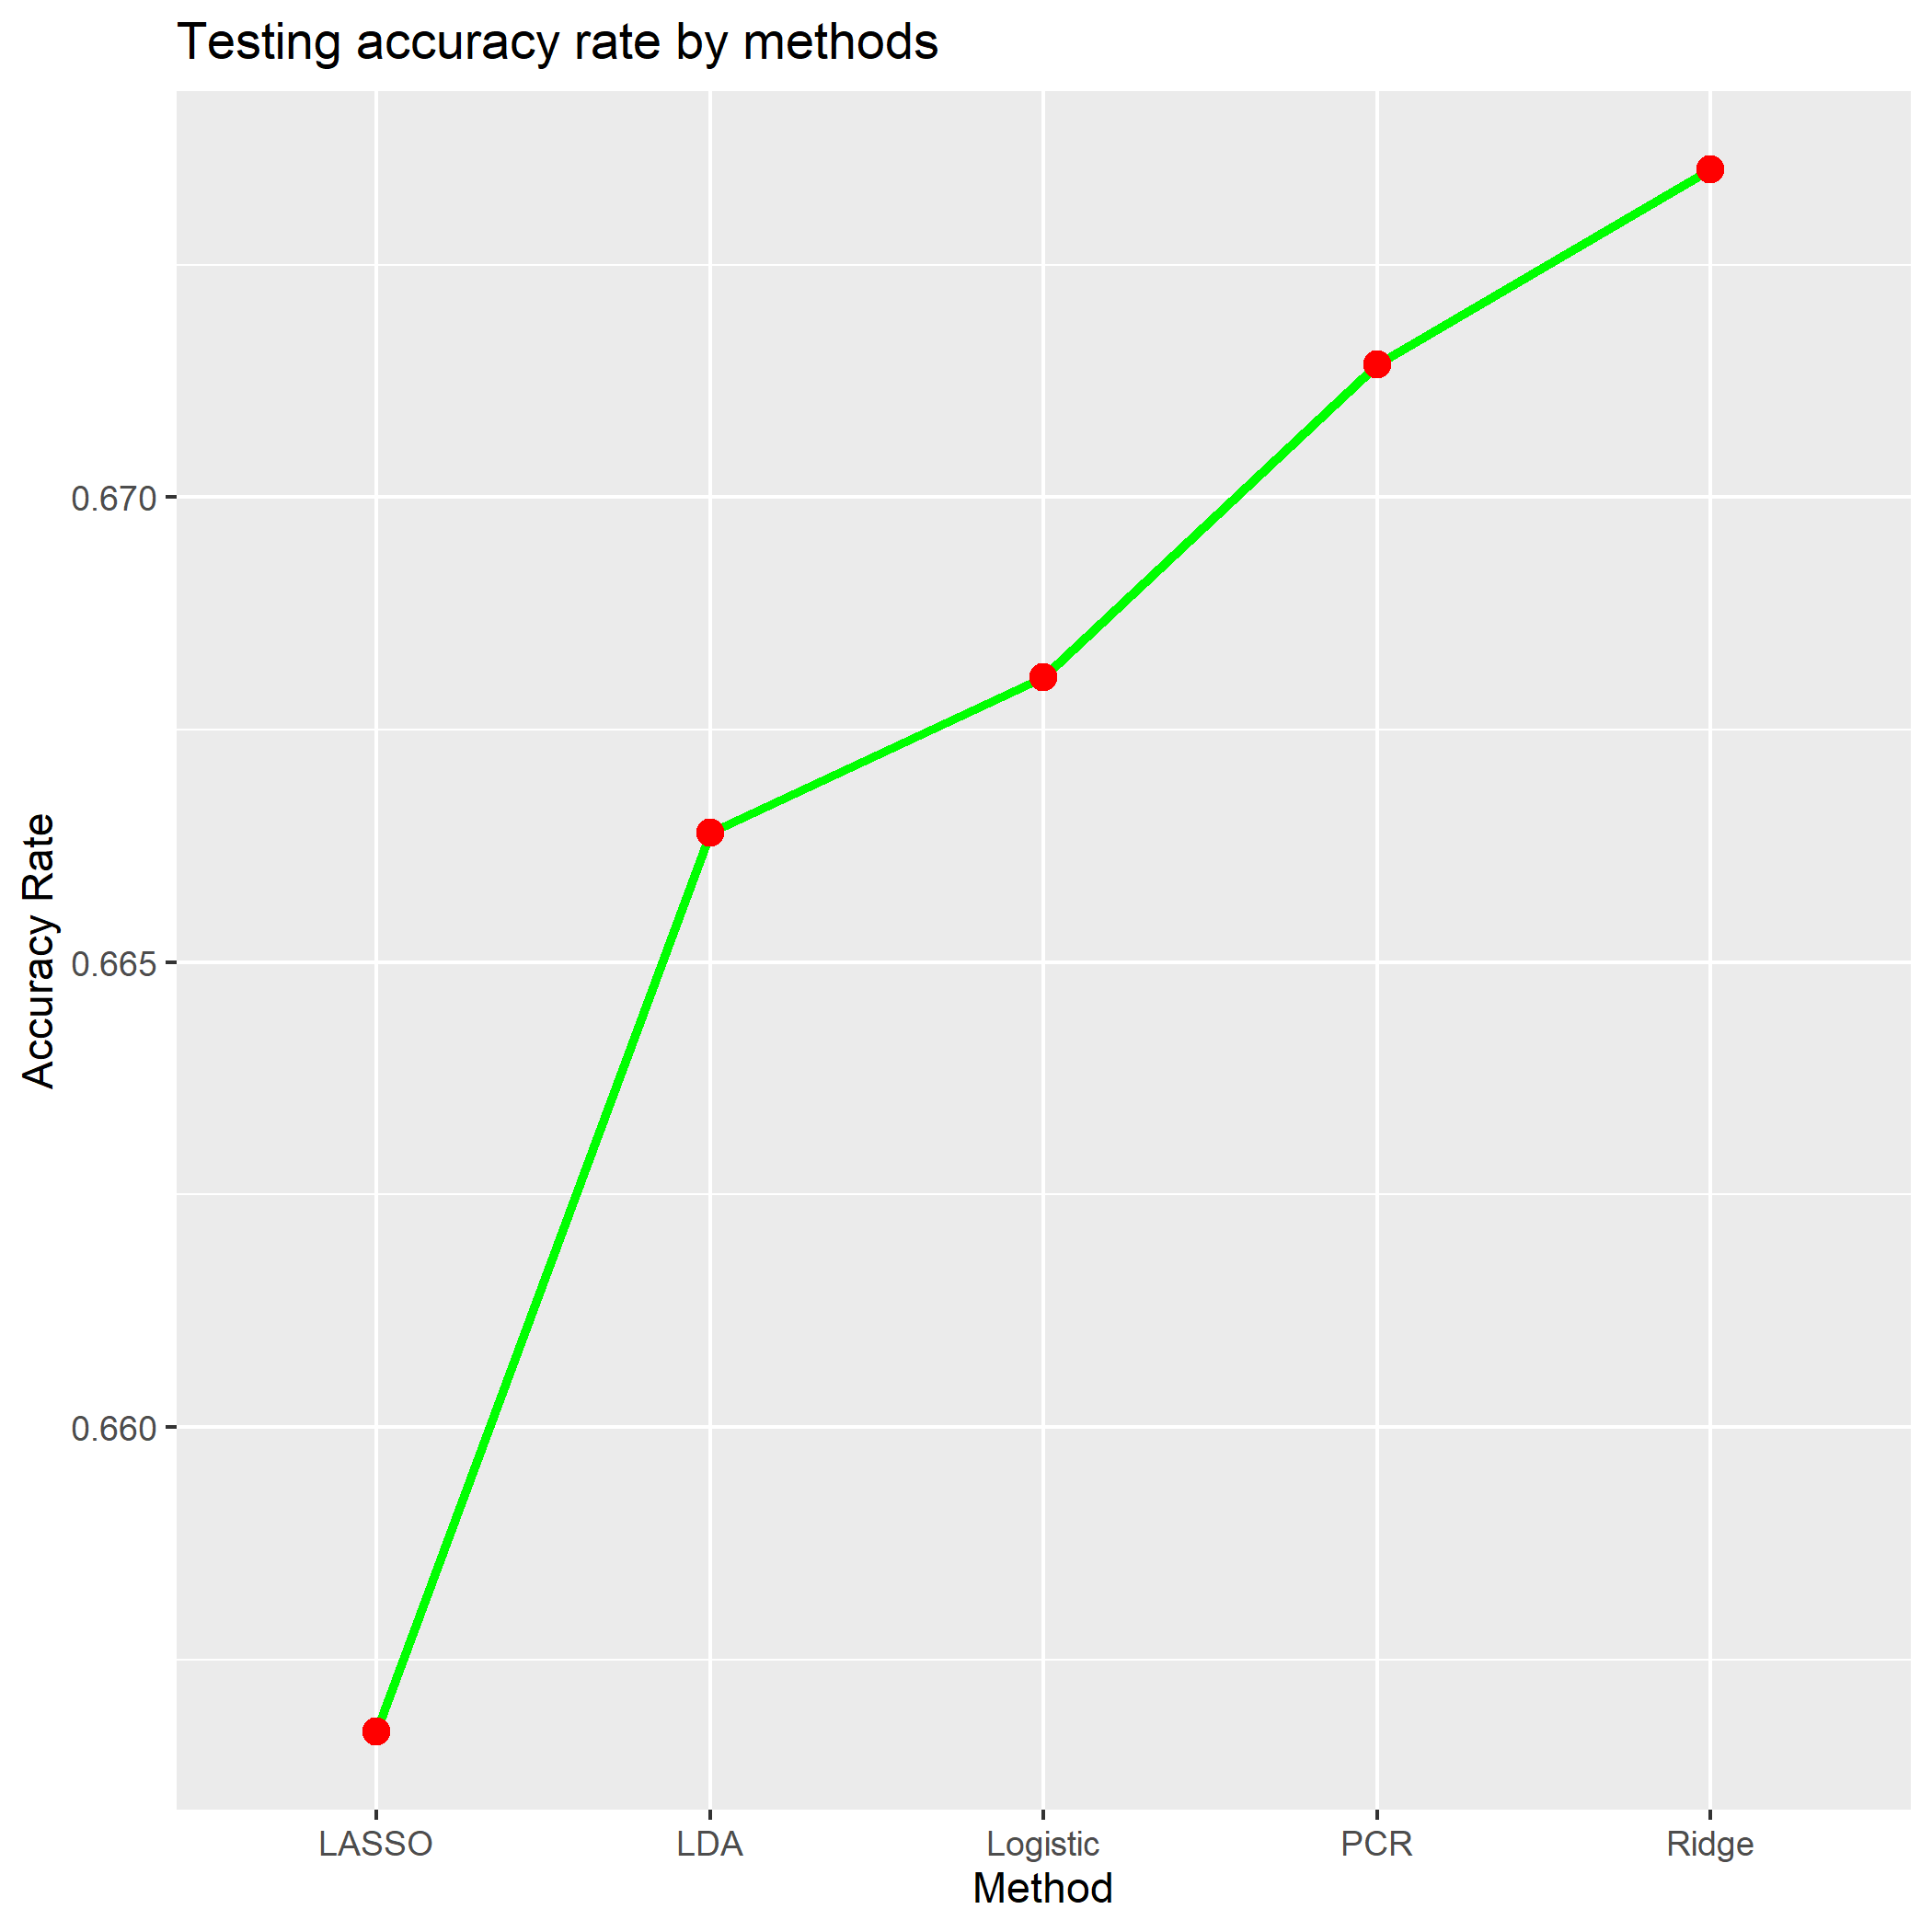
Top 5 Methods

Slide 4
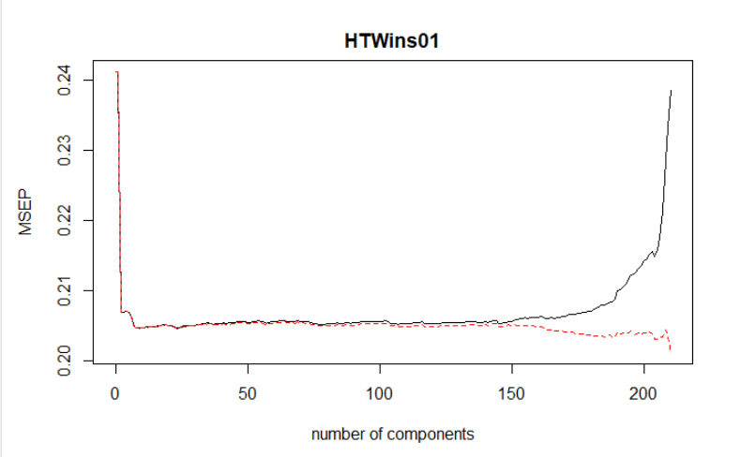
Best Model-PCR
Our best model utilized Principal Component Regression accompanied by cross validation

Slide 5
Why PCR?
Resolves Correlation Issues
PCR reduces complexity while capturing the variance explained by variables
ex) PCR resolved multicollinearity between the variables “fgm” and “fga”
Works very well with large data sets
One of the higher accuracy rates among all the methods

Slide 6
Summary
Accuracy Rate: about 67%
What we tried: Different generalized models and classification methods.
What worked: Ridge Regression and Principal Component Regression
What didn’t work: Predicting using only more recent data

